Slide 3
From last time: on-policy vs off-policy
On-policy
Take an action
Observe a reward
Choose the next action
Learn (using chosen action)
Take the next action
Off-policy
Take an action
Observe a reward
Learn (using best action)
Choose the next action
Take the next action
Key distinction: is the learning formula using a max or a pre-selected action?
What is the effect on current estimates of state-action utilities?

Slide 4
Today’s learning goals
At the end of today, you should be able to
Estimate the probability of events from observed samples
Calculate joint, conditional, and independent probabilities from a joint probability table
Calculate joint probabilities from conditional probabilities
Explain Bayes’ Rule for conditional probability

Slide 5
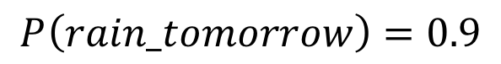
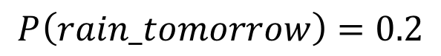
What is probability?
Basically, how likely do I think it is for something to happen?
Example: raining tomorrow
I really, really expect it to rain tomorrow
90% of tomorrows will be rainy
$$P\left(rain_tomorrow\right)=0.9$$
I’d be amazed if it rained tomorrow
20% of tomorrows will be rainy
$$P\left(rain_tomorrow\right)=0.2$$

Slide 6
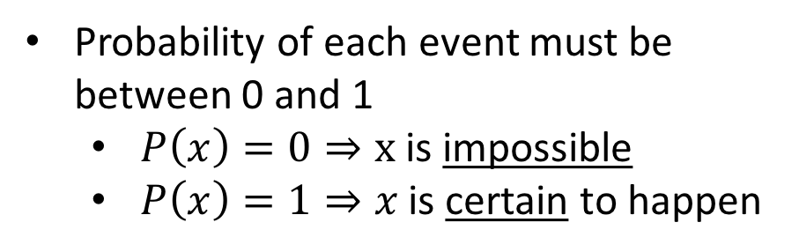
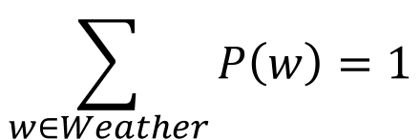
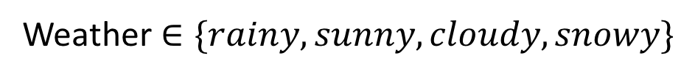
Properties of probability
Typically think about probability distributions over possible events
Weather $∈\{rainy, sunny, cloudy,snowy\}$
Assuming these are the only possible kinds of weather!
Probability distributions must always sum to 1
Probability of each event must be between 0 and 1
$P\left(x\right)=0⇒x$ is impossible
$P\left(x\right)=1⇒x$ is certain to happen
$$\sum_{w∈Weather}{P\left(w\right)=1}$$

Slide 7
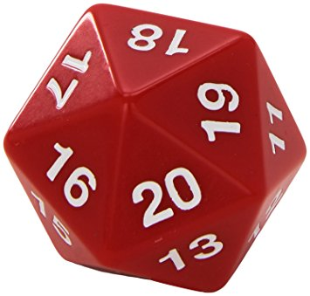
Random variables
A random variable is some aspect of the world about which we are uncertain
Examples: weather right now, coin flip, D20
Has a domain (set of possible values)
E.g., {true, false}, {rainy, sunny, cloudy, snowy}, [0,1]
Describe with a probability distribution over the domain
Distribution is uniform if all probabilities are equal
Notation
CamelCase is a variable (e.g. Weather)
lowercase is an assignment to it (e.g. rain, sun)

Slide 8
Probability tables
Categorical distributions can be represented as tables
Side | P(s) | Side | P(s)
1 |  | 11
2 |  | 12
3 |  | 13
4 |  | 14
5 |  | 15
6 |  | 16
7 |  | 17
8 |  | 18
9 |  | 19
10 |  | 20
Side | P(s) | Side | P(s)
1 | 0.05 | 11 | 0.05
2 | 0.05 | 12 | 0.05
3 | 0.05 | 13 | 0.05
4 | 0.05 | 14 | 0.05
5 | 0.05 | 15 | 0.05
6 | 0.05 | 16 | 0.05
7 | 0.05 | 17 | 0.05
8 | 0.05 | 18 | 0.05
9 | 0.05 | 19 | 0.05
10 | 0.05 | 20 | 0.05

Slide 9
Estimating probability distributions
We usually don’t know the true underlying distribution! But we can observe things that actually happen.
How would you try to estimate a probability distribution?
Try to think of at least 2 ways.
Hint: think about Reinforcement Learning!
Notes:
2 minute think-pair-share

Slide 10
Estimating probability distributions
Two standard approaches to estimating a distribution from evidence:
Frequentist
Make a bunch of observations, look for aggregate patterns
Count and divide!
Basically: how often does this happen?
Bayesian
Start with some expectation of the outcome
Observe the next outcome and adjust
Basically: how likely is this to be the next outcome I see?

Slide 11



Count and divide
Let’s say we’re learning to predict the weather. We get the following 10-day observation sequence:
Sun
Sun
Clouds
Rain
Sun
Clouds
Clouds
Sun
Sun
Sun

Slide 12

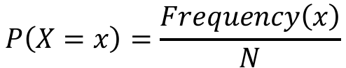
Count and divide
$$P\left(X=x\right)=\frac{Frequency\left(x\right)}{N}$$
Now, for each possible weather category:
Count up observations of that category
Divide by the total number of observations (N)
Weather | P(w)
0.6
Sun
Sun
Clouds
Rain
Sun
Clouds
Clouds
Sun
Sun
Sun

Slide 13
Count and divide
$$P\left(X=x\right)=\frac{Frequency\left(x\right)}{N}$$
Now, for each possible weather category:
Count up observations of that category
Divide by the total number of observations (N)
Weather | P(w)
0.6
0.3
Sun
Sun
Clouds
Rain
Sun
Clouds
Clouds
Sun
Sun
Sun

Slide 14
Count and divide
$$P\left(X=x\right)=\frac{Frequency\left(x\right)}{N}$$
Now, for each possible weather category:
Count up observations of that category
Divide by the total number of observations (N)
Weather | P(w)
0.6
0.3
Sun
Sun
Clouds
Rain
Sun
0.1
Clouds
Clouds
Sun
Sun
Sun

Slide 15
Count and divide
$$P\left(X=x\right)=\frac{Frequency\left(x\right)}{N}$$
Now, for each possible weather category:
Count up observations of that category
Divide by the total number of observations (N)
Weather | P(w)
0.6
0.3
Sun
Sun
Clouds
Rain
Sun
0.1
Clouds
Clouds
Sun
Sun
Sun
0.0

Slide 16
Law of Large Numbers
Each time you roll a die or check the weather for the day, you’re sampling from the underlying probability distribution.
Use N to denote number of samples (sometimes written n)
Small n tends not to give a very accurate estimation of the distribution.
As n increases, the estimated distribution gets closer to the true distribution.
This is called the
Law of Large Numbers

Slide 17
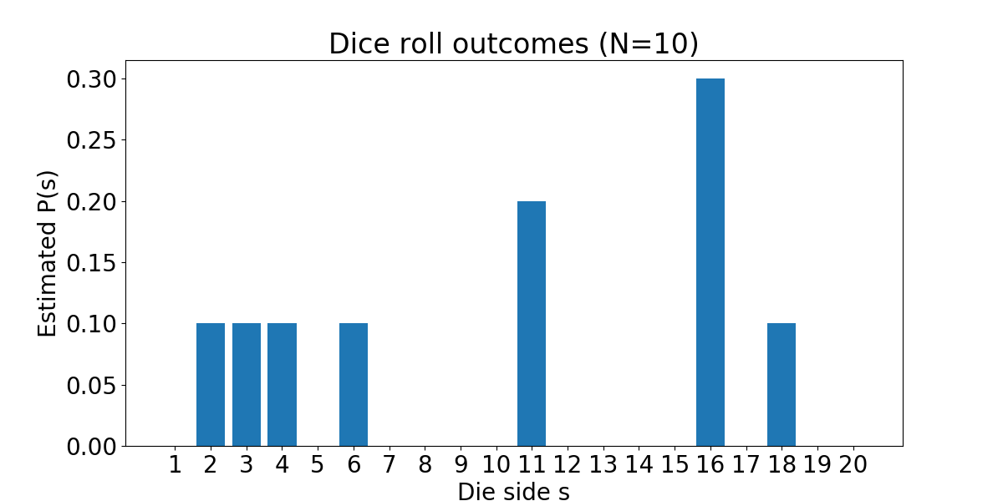
Example: rolling a 20-sided die

Slide 18
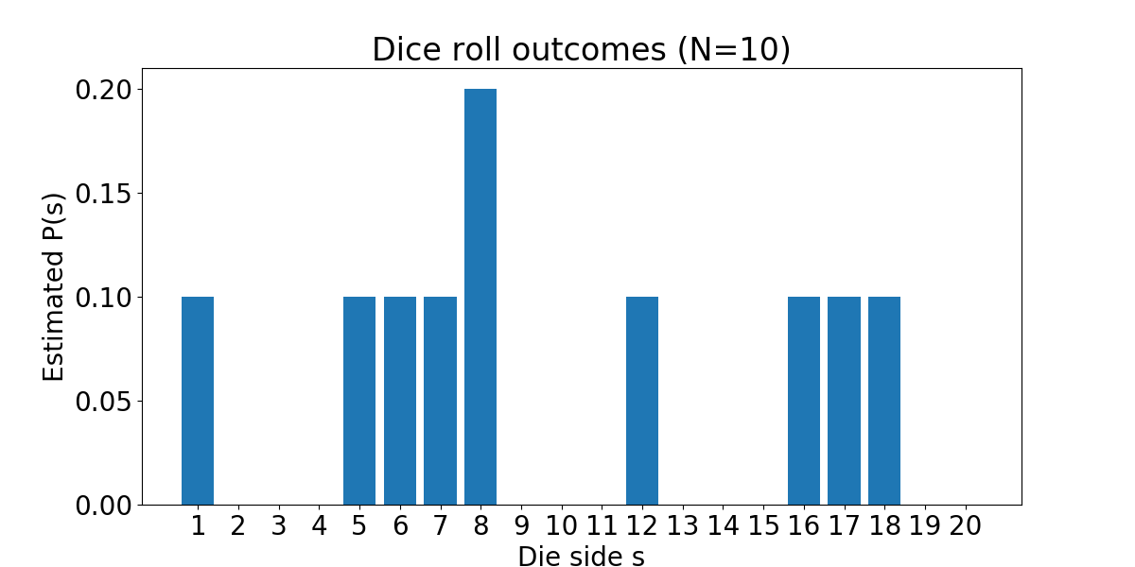
Example: rolling a 20-sided die

Slide 19
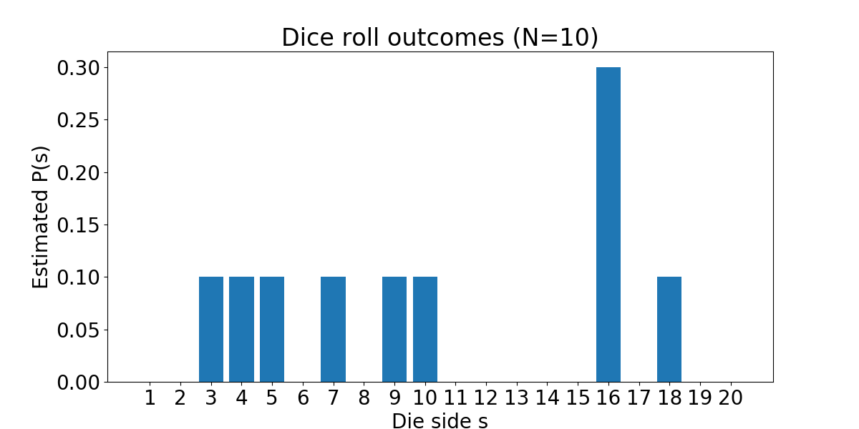
Example: rolling a 20-sided die

Slide 20
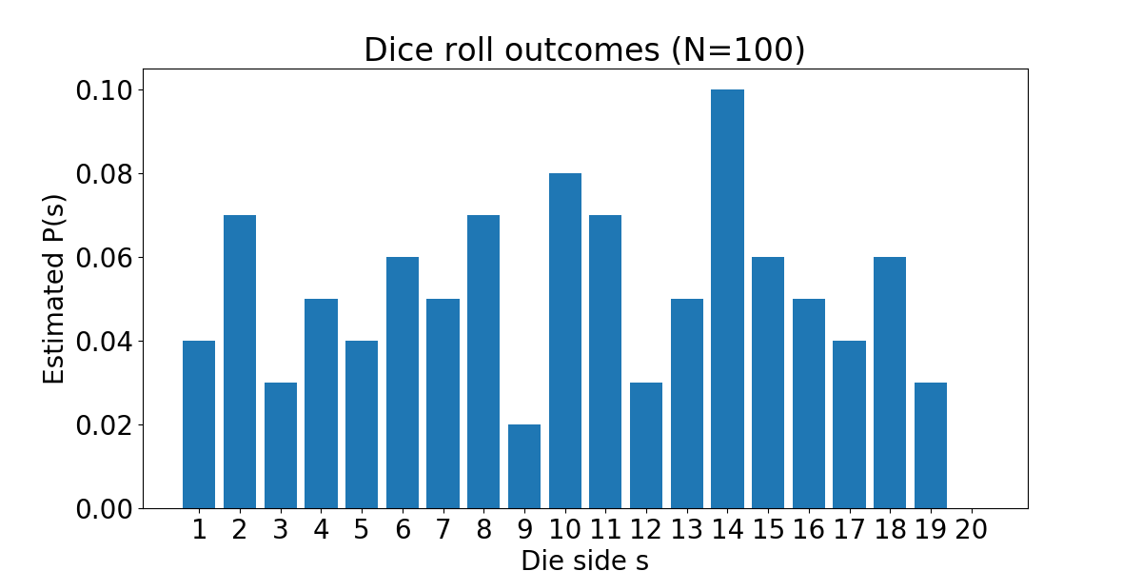
Example: rolling a 20-sided die

Slide 21
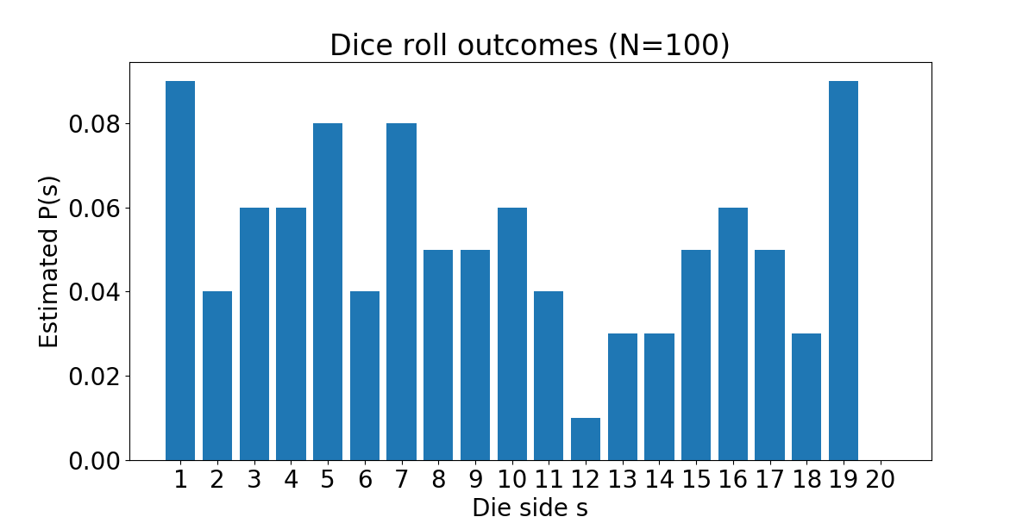
Example: rolling a 20-sided die

Slide 22
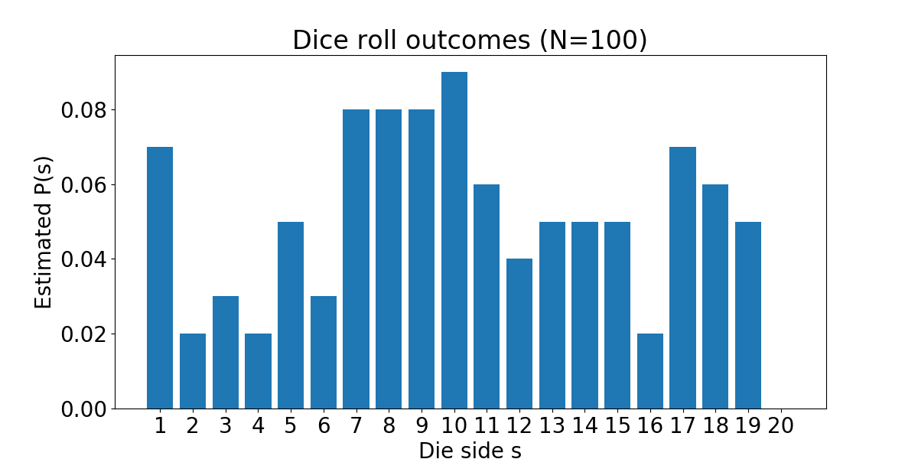
Example: rolling a 20-sided die

Slide 23
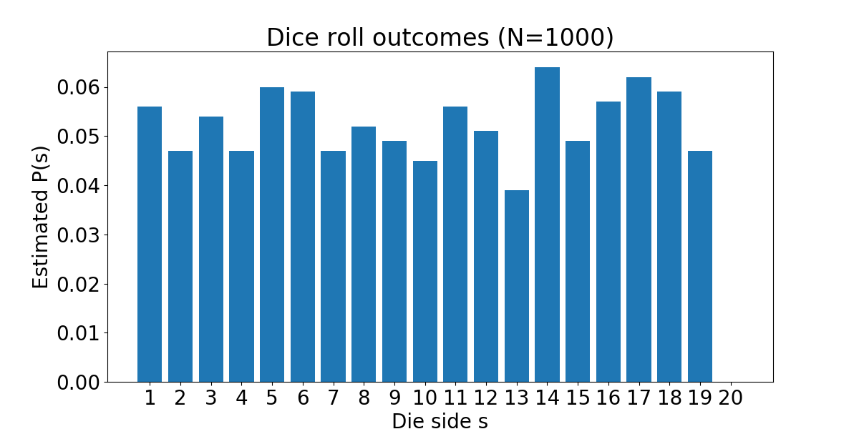
Example: rolling a 20-sided die

Slide 24
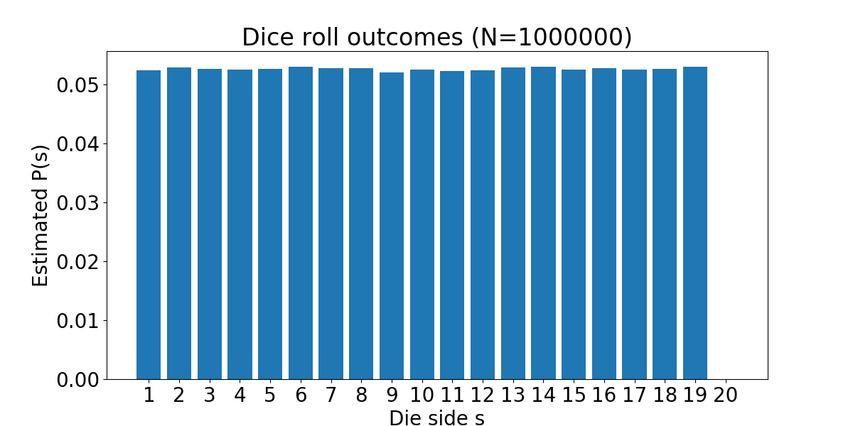
Example: rolling a 20-sided die

Slide 25
Detour: Linking back to RL
We’ve seen this effect before
Think back to Temporal Difference learning
Shows up in expected values as well!
The more samples you take, the closer you get to the true expected value
Directly affected by the underlying probability distribution!

Slide 26
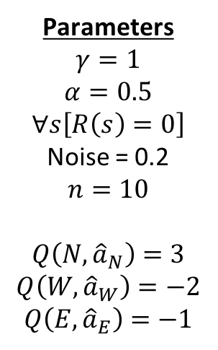
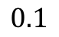
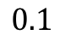
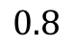
Q value updates with 10 observations
North
Parameters
$$γ=1$$
$$α=0.5$$
$$∀s\left[R\left(s\right)=0\right]$$
Noise = 0.2
$$n=10$$
$$Q\left(N,{\hat{a}}_{N}\right)=3$$
$$Q\left(W,{\hat{a}}_{W}\right)=−2$$
$$Q\left(E,{\hat{a}}_{E}\right)=−1$$
3
Observations
W
N
W
W
N
N
N
W
E
N
3
3
3
3
West
$$0.8$$
East
-2
-2
$$0.1$$
$$0.1$$
1
-1
-2
-2
1.31

Slide 27
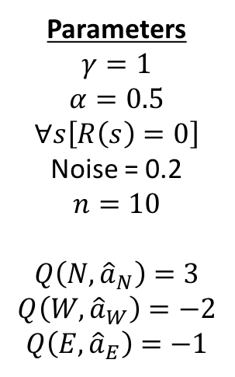
Q value updates with 10 observations
North
Parameters
$$γ=1$$
$$α=0.5$$
$$∀s\left[R\left(s\right)=0\right]$$
Noise = 0.2
$$n=10$$
$$Q\left(N,{\hat{a}}_{N}\right)=3$$
$$Q\left(W,{\hat{a}}_{W}\right)=−2$$
$$Q\left(E,{\hat{a}}_{E}\right)=−1$$
3
3
3
Observations
N
N
N
N
W
N
W
N
N
N
3
3
3
3
3
West
$$0.8$$
East
$$0.1$$
$$0.1$$
-2
1
-2
2.61

Slide 28
Q value updates with 30 observations
North
Parameters
$$γ=1$$
$$α=0.5$$
$$∀s\left[R\left(s\right)=0\right]$$
Noise = 0.2
$$n=10$$
$$Q\left(N,{\hat{a}}_{N}\right)=3$$
$$Q\left(W,{\hat{a}}_{W}\right)=−2$$
$$Q\left(E,{\hat{a}}_{E}\right)=−1$$
3
3
3
Observations
3
3
3
3
3
3
N
N
N
E
N
E
N
N
W
N
W
N
N
N
N
E
E
N
N
N
N
N
N
N
N
N
N
W
N
N
3
3
3
3
3
3
3
3
3
3
3
3
3
3
West
$$0.8$$
East
$$0.1$$
$$0.1$$
1
-1
-2
-2
-1
-2
-1
-1
2.37

Slide 29
Q value updates with 30 observations
North
Parameters
$$γ=1$$
$$α=0.5$$
$$∀s\left[R\left(s\right)=0\right]$$
Noise = 0.2
$$n=10$$
$$Q\left(N,{\hat{a}}_{N}\right)=3$$
$$Q\left(W,{\hat{a}}_{W}\right)=−2$$
$$Q\left(E,{\hat{a}}_{E}\right)=−1$$
3
3
3
Observations
3
3
3
3
3
3
N
N
N
N
W
N
N
E
N
W
N
N
N
N
E
N
N
N
N
N
N
N
N
N
E
W
N
N
3
3
3
3
3
3
3
3
3
3
3
3
3
3
3
West
$$0.8$$
East
$$0.1$$
$$0.1$$
1
-1
-2
-2
-1
-2
-1
2.56

Slide 30
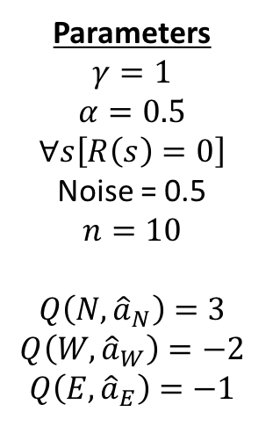
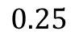
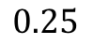
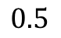
Noisy Q value updates with 10 observations
Parameters
$$γ=1$$
$$α=0.5$$
$$∀s\left[R\left(s\right)=0\right]$$
Noise = 0.5
$$n=10$$
$$Q\left(N,{\hat{a}}_{N}\right)=3$$
$$Q\left(W,{\hat{a}}_{W}\right)=−2$$
$$Q\left(E,{\hat{a}}_{E}\right)=−1$$
North
Observations
N
N
W
N
E
W
W
W
W
N
3
3
3
West
$$0.5$$
East
-2
-2
$$0.25$$
$$0.25$$
-2
1
-1
-2
-2
0.57

Slide 31
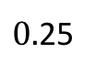
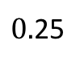
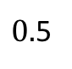
Noisy Q value updates with 30 observations
3
North
Parameters
$$γ=1$$
$$α=0.5$$
$$∀s\left[R\left(s\right)=0\right]$$
Noise = 0.2
$$n=10$$
$$Q\left(N,{\hat{a}}_{N}\right)=3$$
$$Q\left(W,{\hat{a}}_{W}\right)=−2$$
$$Q\left(E,{\hat{a}}_{E}\right)=−1$$
3
3
3
Observations
3
N
N
N
W
W
W
E
E
N
N
N
N
N
N
E
N
W
E
E
E
E
E
W
N
N
N
N
W
N
W
3
3
3
3
3
3
3
3
3
3
East
West
-1
$0.$5
-1
-1
-2
-1
-2
$0.$25
$0.$25
1
-1
-2
-1
-2
-2
-2
-1
-1
-2
-0.16

Slide 32
Joint probability
Most of the time, we’re observing more than one random variable.
E.g.
Weather and temperature
Traffic levels and number of accidents
Email body text, subject line, sender, and spam-ness
Observed assignments to these sets of variables yields a joint probability table, which we can do a lot with!

Slide 33
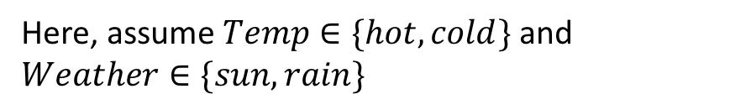
Joint probability tables
Temp | Weather | P(t,w)
hot | sun | 0.4
hot | rain | 0.1
cold | sun | 0.2
cold | rain | 0.3
Each row in the probability table is an assignment to the variables
Note that all probabilities in the joint table still must sum to 1!
Here, assume $Temp∈\{hot,cold\}$ and $Weather∈\{sun, rain\}$
With many variables (and many options for each), actually writing this out is impractical
No matter how tiny each probability gets, it still matters!

Slide 34
Joint probability tables
Easy to answer questions like:
What’s the likelihood of it being hot and sunny?
Is it more likely to be hot and rainy or cold and sunny?
Temp | Weather | P(t,w)
hot | sun | 0.4
hot | rain | 0.1
cold | sun | 0.2
cold | rain | 0.3
But what about questions like:
What’s the likelihood that it’s hot?
If it’s raining, is it more likely to be hot or cold?

Slide 35
Marginalization
Temp | Weather | P(t,w)
hot | sun | 0.4
hot | rain | 0.1
cold | sun | 0.2
cold | rain | 0.3
We can answer questions like
“What’s the probability that it’s hot?”
By eliminating variables from the joint distribution.
Marginalization is summing up the assignment probabilities for the variable you care about over the assignments to the variable you don’t.

Slide 36
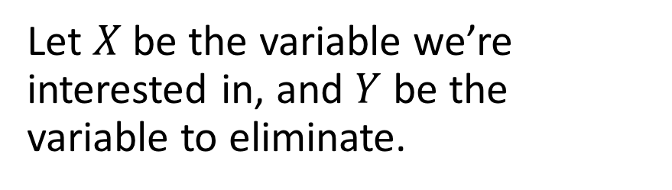
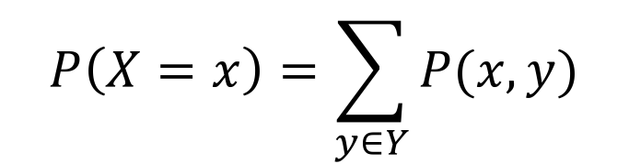
Marginalization
Let $X$ be the variable we’re interested in, and $Y$ be the variable to eliminate.
$$P\left(X=x\right)=\sum_{y∈Y}{P(x,y)}$$
Then
Temp | Weather | P(t,w)
hot | sun | 0.4
hot | rain | 0.1
cold | sun | 0.2
cold | rain | 0.3
Temp | P(t)
hot
cold
0.5
0.5

Slide 37
Marginalization
Let $X$ be the variable we’re interested in, and $Y$ be the variable to eliminate.
$$P\left(X=x\right)=\sum_{y∈Y}{P(x,y)}$$
Then
Temp | Weather | P(t,w)
hot | sun | 0.4
hot | rain | 0.1
cold | sun | 0.2
cold | rain | 0.3
Temp | P(t)
hot | 0.5
cold | 0.5
Weather | P(w)
sun
rain
0.6
0.4

Slide 38
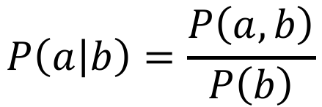
Conditional probability
Conditional probability gives the likelihood of one thing being true, given that something else is true.
Temp | Weather | P(t,w)
hot | sun | 0.4
hot | rain | 0.1
cold | sun | 0.2
cold | rain | 0.3
Definition
$$P\left(a | b\right)=\frac{P\left(a,b\right)}{P\left(b\right)}$$
“The probability of a given b”

Slide 39
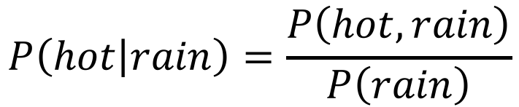
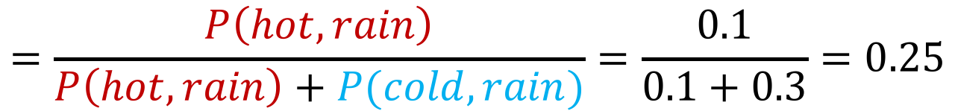
Conditional probability
Temp | Weather | P(t,w)
hot | sun | 0.4
hot | rain | 0.1
cold | sun | 0.2
cold | rain | 0.3
Example question:
“What’s the probability that it’s hot, given that it’s raining?”
$$P\left(hot | rain\right)=\frac{P\left(hot,rain\right)}{P\left(rain\right)}$$
$$=\frac{P\left(hot,rain\right)}{P\left(hot,rain\right)+P(cold,rain)}=\frac{0.1}{0.1+0.3}=0.25$$
Marginalize over Temp to get P(rain)

Slide 40
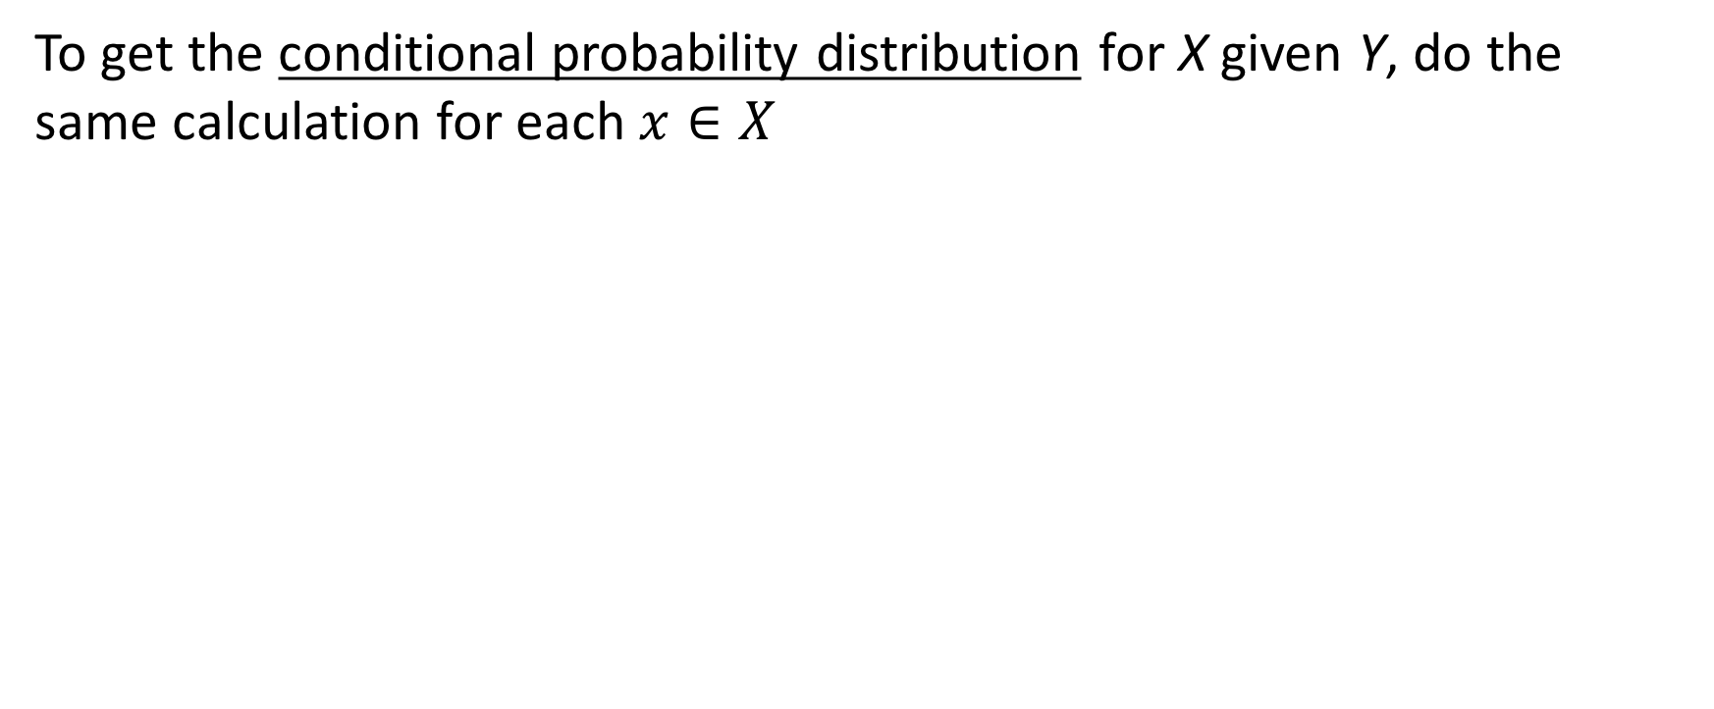
Conditional probability tables
To get the conditional probability distribution for X given Y, do the same calculation for each $x∈X$
Temp | Weather | P(t,w)
hot | sun | 0.4
hot | rain | 0.1
cold | sun | 0.2
cold | rain | 0.3
Temp | P(t|rain)
hot | 0.25
cold | 0.75

Slide 41
Conditional probability tables
To get the conditional probability distribution for X given Y, do the same calculation for each $x∈X$
Temp | Weather | P(t,w)
hot | sun | 0.4
hot | rain | 0.1
cold | sun | 0.2
cold | rain | 0.3
Temp | P(t|rain)
hot | 0.25
cold | 0.75
Temp | P(t|sun)
hot | 0.67
cold | 0.33

Slide 42
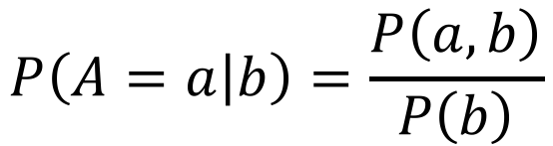
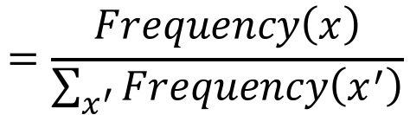
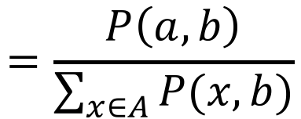
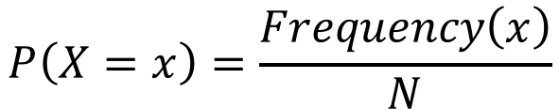
Aside: Normalization
We’ve now seen two equations for calculating distributions
$$P\left(X=x\right)=\frac{Frequency\left(x\right)}{N}$$
$$=\frac{Frequency\left(x\right)}{\sum_{x^{′}}{Frequency\left(x^{′}\right)}}$$
Count and divide
$$P\left(A=a | b\right)=\frac{P\left(a,b\right)}{P\left(b\right)}$$
$$=\frac{P\left(a,b\right)}{\sum_{x∈A}{P(x,b)}}$$
Conditional distribution
In both cases, dividing by the sum of possible numerator values
This is called normalization
Very common way to get something that sums to 1 (e.g., probability distribution)

Slide 43
Great! Now what?
We can now do the following
Calculate a joint probability table from samples
Get the probability of a single event via marginalization
Get conditional probability via normalization
These all generalize to more than two variables pretty straightforwardly (recursion!)
What if we can’t get the necessary samples?

Slide 44
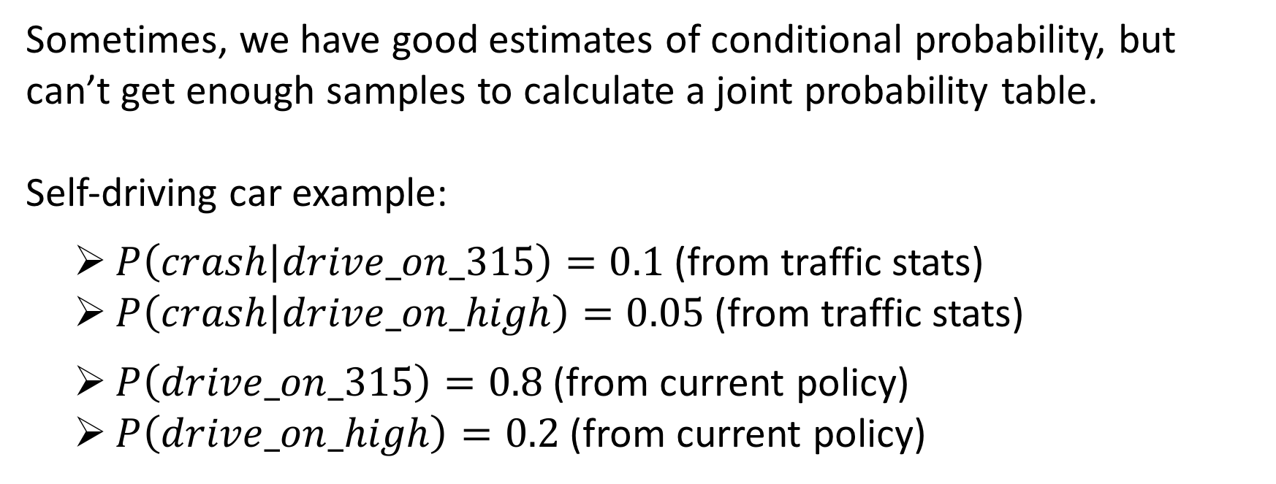
From conditional to joint probability
Sometimes, we have good estimates of conditional probability, but can’t get enough samples to calculate a joint probability table.
Self-driving car example:
$P\left(crash | drive_on_315\right)=0.1$ (from traffic stats)
$P\left(crash | drive_on_high\right)=0.05$ (from traffic stats)
$P\left(drive_on_315\right)=0.8$ (from current policy)
$P\left(drive_on_high\right)=0.2$ (from current policy)
$$P\left(drive_on_high,crash\right)= ???$$

Slide 45
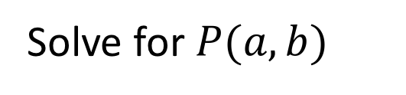
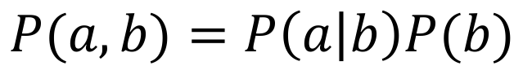
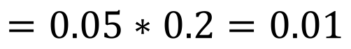
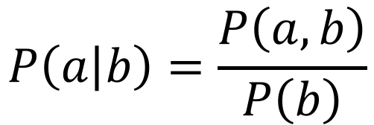
The Product Rule
$$P\left(a | b\right)=\frac{P\left(a,b\right)}{P\left(b\right)}$$
Conditional probability
Solve for $P(a,b)$
$$P(a,b)=P\left(a | b\right)P(b)$$
The product rule!
$$P\left(drive_on_high,crash\right)=P\left(crash | drive_on_high\right)P(drive_on_high)$$
$$=0.05∗0.2=0.01$$

Slide 46
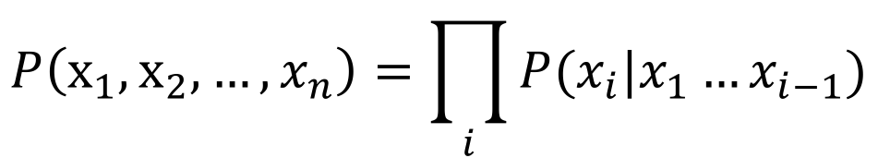
The Chain Rule (for probability)
In general, can rewrite any joint probability distribution as an incremental product of conditional distributions
E.g. for three variables
$$P\left(x_{1},x_{2},x_{3}\right)=P\left(x_{3} | x_{1},x_{2}\right)P\left(x_{2} | x_{1}\right)P(x_{1})$$
General case
This is just a generalization of the Product Rule!
$$P\left(x_{1},x_{2},…,x_{n}\right)=\prod_{i}{P(x_{i}|x_{1}…x_{i−1})}$$

Slide 47

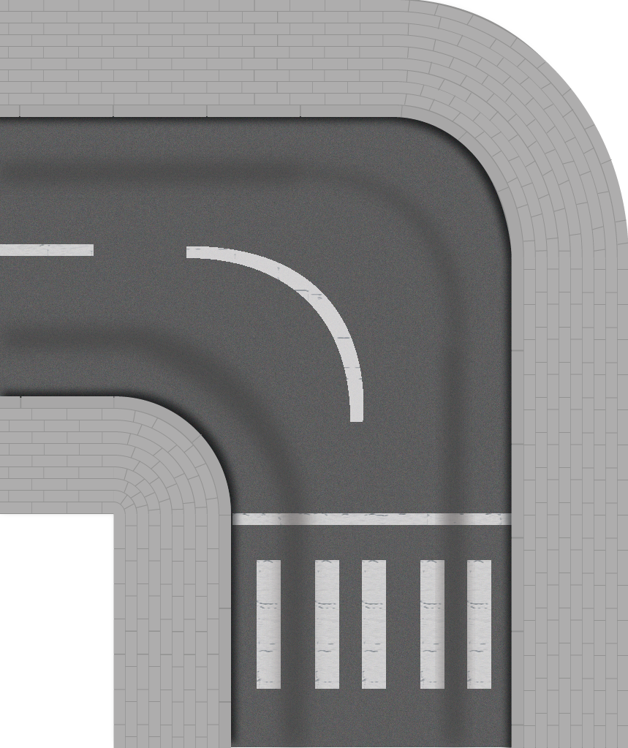



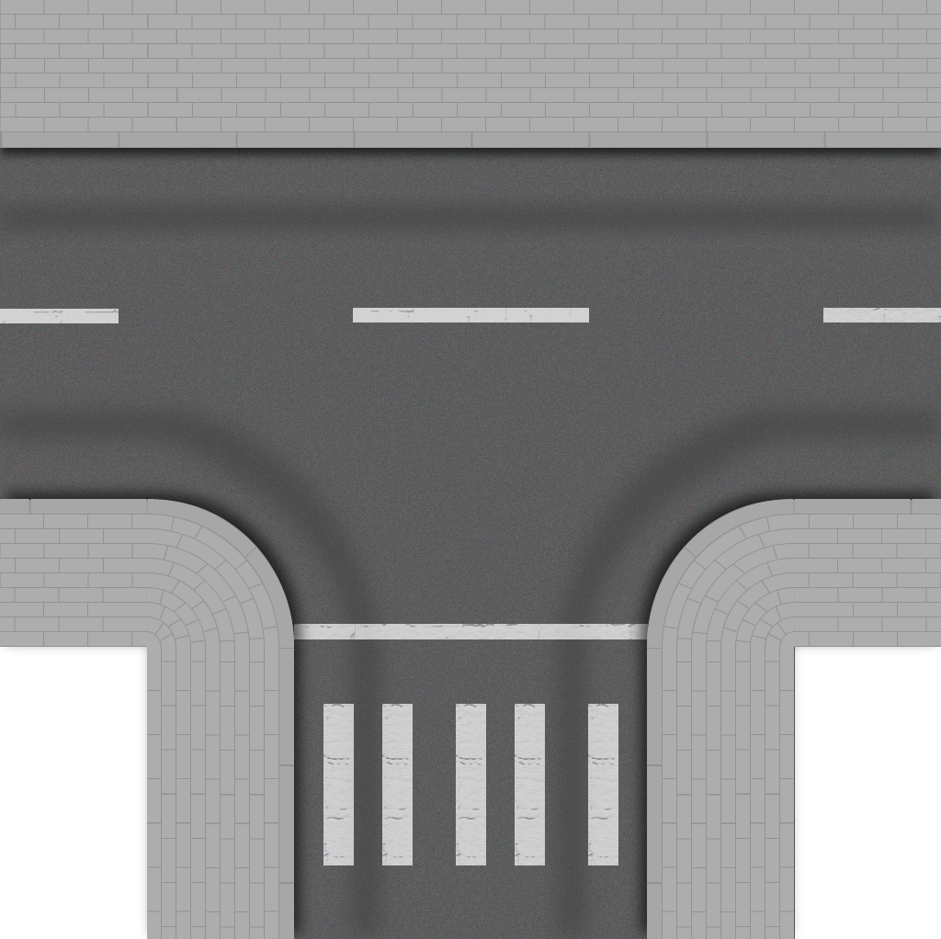

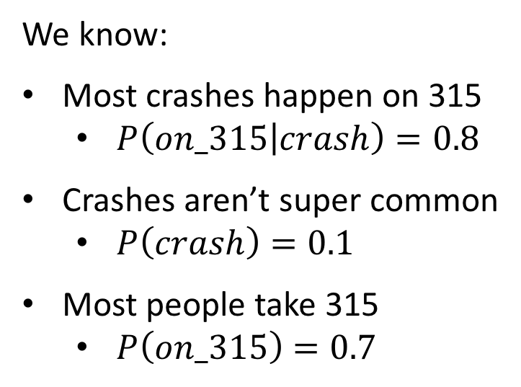
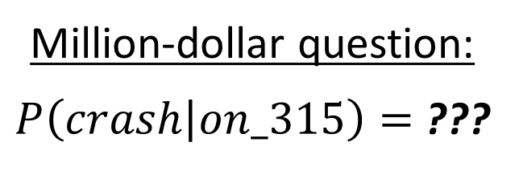
Working with conditional probability
Example problem
Route choosing for a self driving car, but with incomplete information.
We know:
Most crashes happen on 315
$P\left(on_315 | crash\right)=0.8$
Crashes aren’t super common
$P\left(crash\right)=0.1$
Most people take 315
$P\left(on_315\right)=0.7$
Million-dollar question:
$P\left(crash | on_315\right)=$ ???

Slide 48
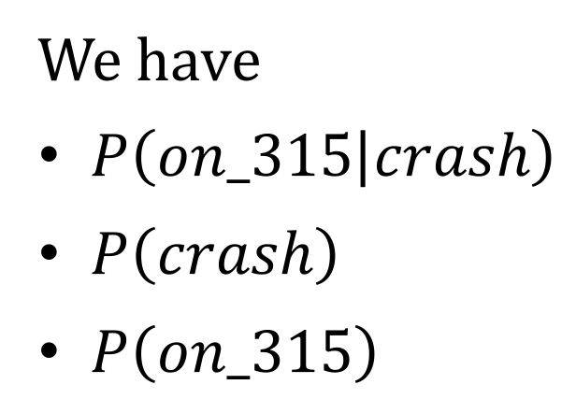
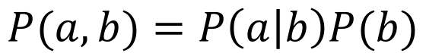


Working with conditional probability
We have
$P\left(on_315 | crash\right)$
$P\left(crash\right)$
$P\left(on_315\right)$
Product rule
$$P(a,b)=P\left(a | b\right)P(b)$$
Conditional probability
$$P\left(a | b\right)=\frac{P\left(a,b\right)}{P\left(b\right)}$$
We want
$P\left(crash | on_315\right)$
How do we get here?
Notes:
Think/pair/share

Slide 49



Bayes’ Rule
Product rule can be expanded in two different ways:
$$P\left(a,b\right)=P\left(a | b\right)P\left(b\right)=P\left(b | a\right)P(a)$$
Solving for $P(a|b)$ gives
$$P\left(a | b\right)=\frac{P\left(b | a\right)P\left(a\right)}{P\left(b\right)}$$
This is Bayes’ Rule, and is probably the most important formula in AI!
Rev. Thomas Bayes (1701-1761)

Slide 50




Working with conditional probability
We have
$P\left(on_315 | crash\right)=0.8$
$P\left(crash\right)=0.1$
$P\left(on_315\right)=0.7$
Product rule
$$P(a,b)=P\left(a | b\right)P(b)$$
Conditional probability
$$P\left(a | b\right)=\frac{P\left(a,b\right)}{P\left(b\right)}$$
$$P\left(crash | on_315\right)=\frac{P\left(on_315 | crash\right)P\left(crash\right)}{P\left(on_315\right)}$$
Bayes’ rule
$$=\frac{0.8∗0.1}{0.7}≈0.114$$
$$P\left(a | b\right)=\frac{P\left(b | a\right)P\left(a\right)}{P\left(b\right)}$$
11.4% chance of getting in an accident if we go on 315.

Slide 51

Recap exercise
Cookies | Semester | P(t,w)
in_stock | fall | 0.10
in_stock | spring | 0.20
in_stock | summer | 0.30
sold_out | fall | 0.23
sold_out | spring | 0.13
sold_out | summer | 0.03
Using the joint probability table at right, calculate
(1) $P\left(spring\right)$
(2) $P\left(sold_out | fall\right)$
What’s the biggest question you have from today’s class?

Slide 52
Next time
Bayesian inference and learning
Types of probability distributions

